Slide 1
Unit 5

Slide 2
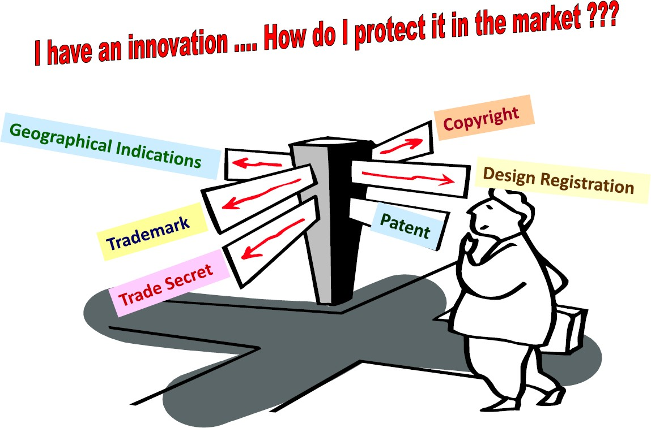





“Intellectual property”

Slide 3
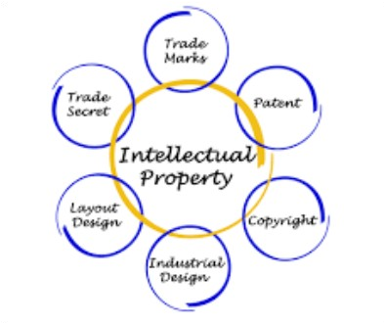
INTELLECTUAL PROPERTY
The term ‘intellectual property’ (IP) refers to property created with the use of human intellect. IP refers to all creations of mind which are vested with the status of property because of the commercial value associated with the intellectual creation. i.e. inventions in all fields of human endeavor, scientific discoveries, industrial designs for article, literary & artistic work, symbols etc. used in commerce.
Nature/ characteristics of Intellectual Property:
•
•
•
•
Creation of human mind (Intellect) Intangible property (not physical)
Exclusive rights given by statutes
Time-bound and Territorial/Jurisdictional

Slide 4

What is Intellectual Property
Right (IPR)?
Intellectual Property Right
not to be confused with IP
it is a right vested in the asset, not the asset itself
e.g.
an idea / invention is IP, a patent registration is an IPR
a customer / price list is IP, a right of confidentiality is an IPR
a secret production method is IP, a right to a trade secret is an IPR
a particular way of representation is IP, copyright or a design registration
■
■
■
is an IPR
a brand / trade name is IP, a trade mark registration is an IPR
3

Slide 5
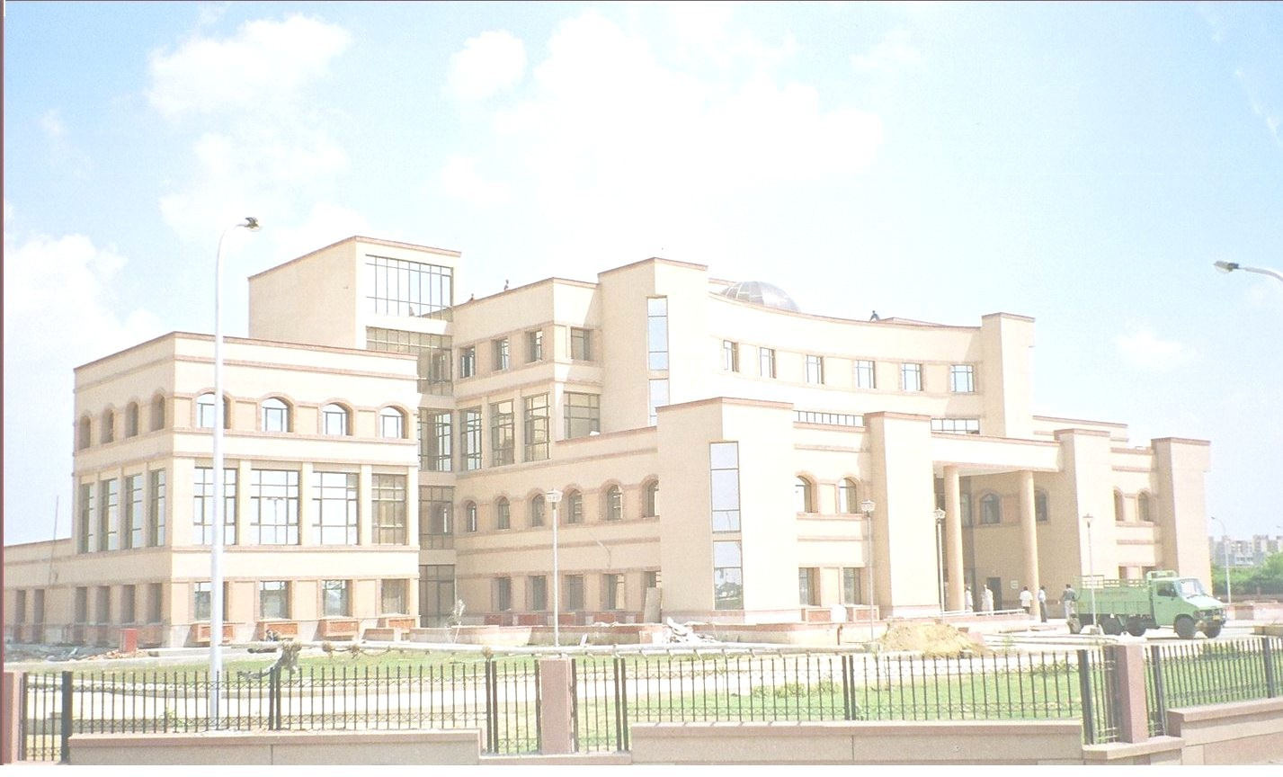





Intellectual property in India
INDUSTRIAL PROPERTY
+
COPY RIGHT
PATENTS
DESIGNS
TRADEMARKS
Geographical Indications
Patent Information
Patents
& Designs
Trade Marks
Copy Right
Geographical Indications

Slide 6
INDUSTRIAL PROPERTY
Patents | Designs | Trade- Marks | Geographical Indications
Inventions relating to constructional features | any modification in shape,pattern, configuration | Word Name Logo | Indications of source origin or geography
e.g. Safety Valve, Mechanism of a PRESSURE COOKER | e.g. shape of a handle or body portion of a pressure cooker | e.g. for same Pressure Cooker “PRESTIGE” “HAWKINS” “MAHARAJA” | Darjeeling tea Kanchipuram sarees KolhapurI chappals

Slide 7
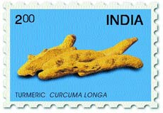
Two American researchers of Indian origin, Suman K. Das and Hari Har P. Cohly of the University of Mississippi Medical Center, put a claim to the US Patent and Trademark Office, maintaining that they had discovered haldi's healing properties. And, surprise, they were granted a patent in March 1995 for something you had known for years and our ayurveds for centuries.
The Council of Scientific and Industrial Research (it has all these big government laboratories under it and is better known by its acronym CSIR) last year applied to the US Patent Office for a reexamination.
1997, the US Patent Office acknowledged it had made a mistake and cancelled the patent on turmeric. This is a major victory because seldom does it fully revoke a patent it has granted.

Slide 8
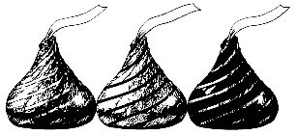




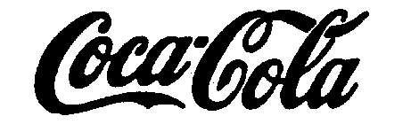


‘Trade Mark’ – Definition under the Trade Marks Act 1999
Trade mark means, a mark capable of being represented graphically and which is capable of distinguishing the goods or services of one person from those of others and may include shape of goods, their packaging and combination of colures….
"mark" includes a device, brand, heading, label, ticket, name, signature, word, letter, numeral, shape of goods, packaging or combination of colours or any combination thereof;
[S. 2 (1) (zb) Trade Marks Act 1999]
JUST DO IT.

Slide 9
Notice of Registration
®
TM
is a trademark/service mark of
SM

Slide 10
Purpose & functions of a Trademark
To identify the origin of the product/service.
To distinguish the product/service of the proprietor from those of others.
To guarantee the quality of the product/service, and
To advertise the product/service.

Slide 11
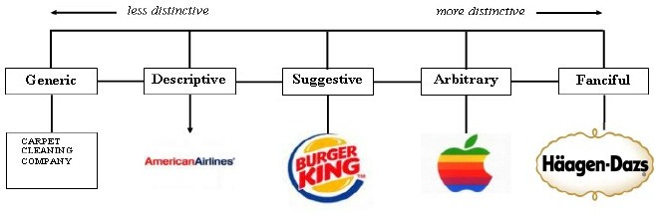
Selecting a Mark
Distinctiveness Spectrum
The more distinctive the mark, the greater its level of legal protectability. Generic marks are not capable of trademark protection. Descriptive marks are capable of protection only with a showing of secondary meaning.

Slide 12
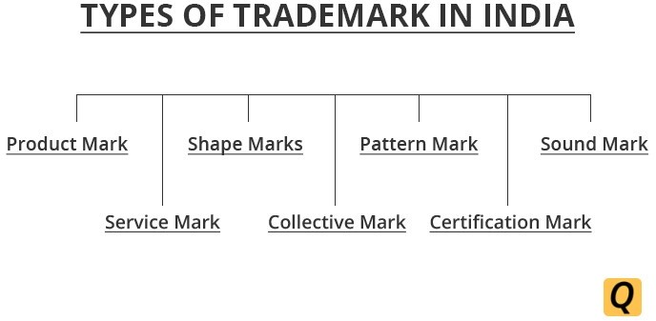
10

Slide 13

Product Mark
•
A product mark is similar to trademark only, but it is to identify the products or goods instead of services. Herein the product is the unique selling feature of the company. Initially, TM, which states that the mark is not yet registered. Once they are registered, they have to use ®.
Examples: Pepsi®, Maggi®, PHILIPS® etc.
•
11

Slide 14
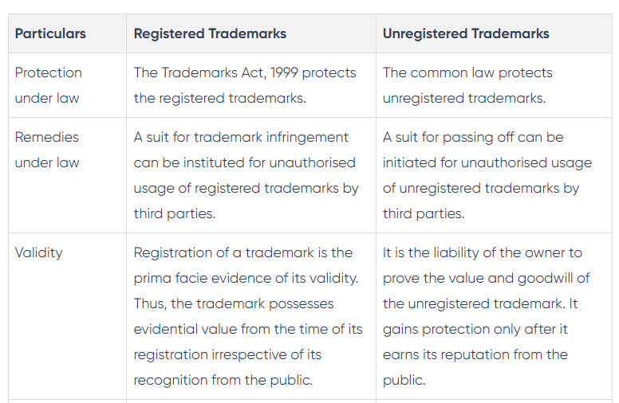

Slide 15
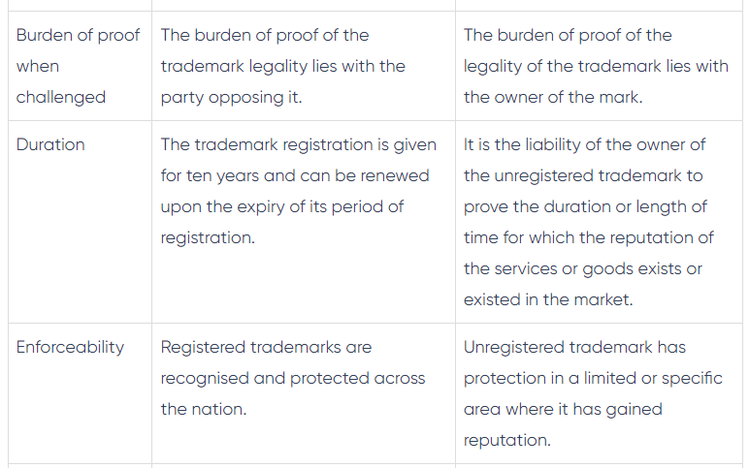

Slide 16
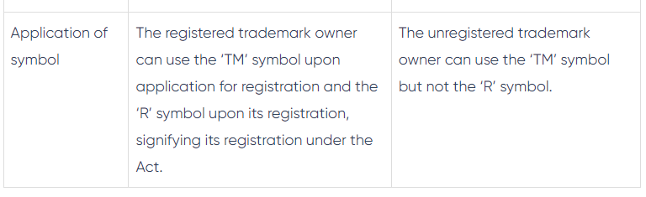

Slide 17

Service Mark
•
This type of trademark is used to identify and distinguish the services rather than the products.
Like intangible products , transport, communication or other utilities such as electricity, water, routine maintenance or repair work, etc.
The Service marks have their particular symbol which is SM and not TM.
•
•
12

Slide 18

Collective Mark
A collective mark is owned by a collective, whose members use the collective mark to identify their goods and services and to distinguish their goods and services from those of non-members, and to indicate membership in the group.
Examples are like "CA" device is used by the members who fall under Institute of Chartered Accountants; another example is "CPA" which denotes members of the Society of Certified Public Accountants.
13

Slide 19
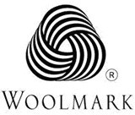

Certification marks
Certification marks are used to define "standard" of goods and services.
Example: Woolmark, which is certified for the fabrics on clothing, Agmark, and ISI.
14

Slide 20
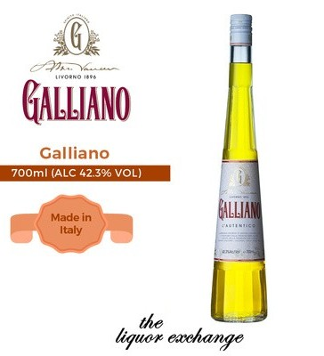
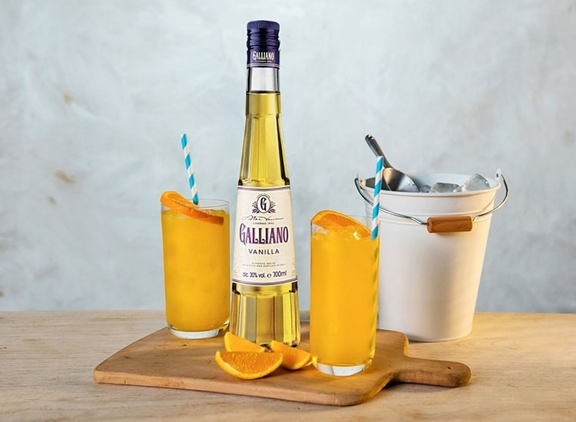
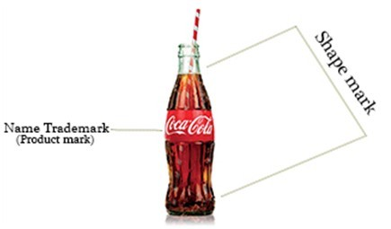
Shape Marks
To sum up shape trademarks, it has facilitated promotion of products and emerged into the trademark type after the technological advancement of graphics and other forms of animation technology. The graphical representation which is able to make a difference amongst the products can be shape marked. An example can be the Galliano liquor bottle.
15

Slide 21
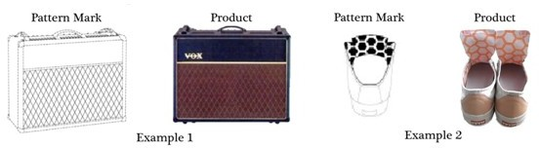
Pattern Mark
•
The general meaning of pattern is a repetition of similar design, so it is a type of trademark wherein the pattern is able to distinguish the product and services of one brand from another. These are difficult to be distinguished and have high chances of infringement with near similar designs.
They at times, fail to make a distinction and the registration would not be accepted unless they have evidence of distinctiveness.
•
16

Slide 22
Sound Mark
A musical composition, jingle or sound can play a vital role in brand recollection and enrich the brand value of a business. The concept of sound marks explored, exploited and protected in India definitely opens up its own world of branding.
Now, especially with the explicit recognition given to sound as a trademark under the new Trade Marks Rules 2017 as issued on 6 March 2017
The first Sound Mark to be registered in India was Yahoo yodel followed by Nokia tune.
17

Slide 23

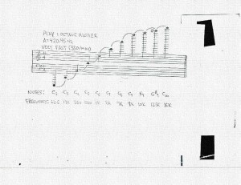

Slide 24
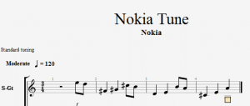
The European Union has registered the signature tone of Nokia Corporation as below:

Slide 25
Loss of Rights
Abandonment; non use of mark for longer period
Failing to stop others who cause confusion;
“Genericide” of a Trademark
A trademark may become lost through the acts or omissions of the owner which cause the trademark to become descriptive of the good or service. Generic use of a word results when a substantial majority of the public associates that word with the category of goods or services rather than as an indication of a specific product, source or manufacturer.
For example, the word “aspirin,” once trademarked, is now a generic word to consumers.

Slide 26
Loss of Rights
Improper licensing of the rights;
A significant change in quality or character of the goods or services.

Slide 27
Benefits of Registration of a trademark
•
Registration is prima facie evidence of proprietorship of the trademark
•
It gives the exclusive right to use the trademark in respect of goods/services; and to take legal action in case of infringement
•
The registered proprietor may assign or license the trademark as any other property
•
The registered proprietor can enjoy the Goodwill associated with registered trademark forever, if the mark is renewed from time to time

Slide 28
Selecting a good Trademark
Go for a trademark which is-
•
•
•
Easy to speak & spell (in case of word mark),
Appealing and easy to remember or recollect.
invented or coined word, unique monogram, logo or a geometrical device
Don’t go for a trademark -
•
Which is not capable of distinguishing your goods or services from those of others- like one/two digit letters or numerals, common surnames/ names, words or pictures of the product concerned, etc. …………………………..[Section 9(1)(a)]
Which refers to character or quality of goods/services concerned, which indicate geographical origin, which are common to trade,..[Section 9(1) (b) & (c)]
a deceptive, scandalous or offensive matter or a matter prohibited by law to be used as a trademark,………………………………………………………………….[Sections 9(2)(3) & 13 ] a mark which is same/similar to an already existing trademark,…[Section 11]
•
•
•

Slide 29
Appropriate form and fee
At present there are many forms prescribed for filing new applications depending on the nature of application such as Form TM-1, TM-2, TM-51, TM-52 TM-3, TM-8 etc.
Fee ordinarily Rs.4000/-per class
[In the proposed revised rules there will be only one form for all types of applications for registration of trademarks.]
https://ipindia.gov.in/

Slide 30
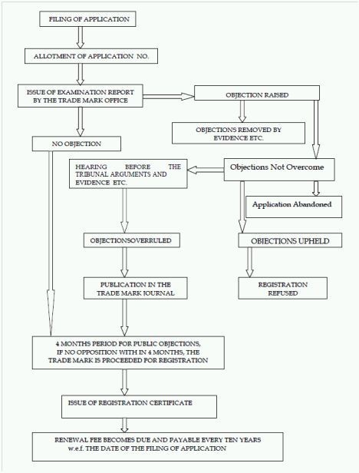
Steps involved in registration process

Slide 31
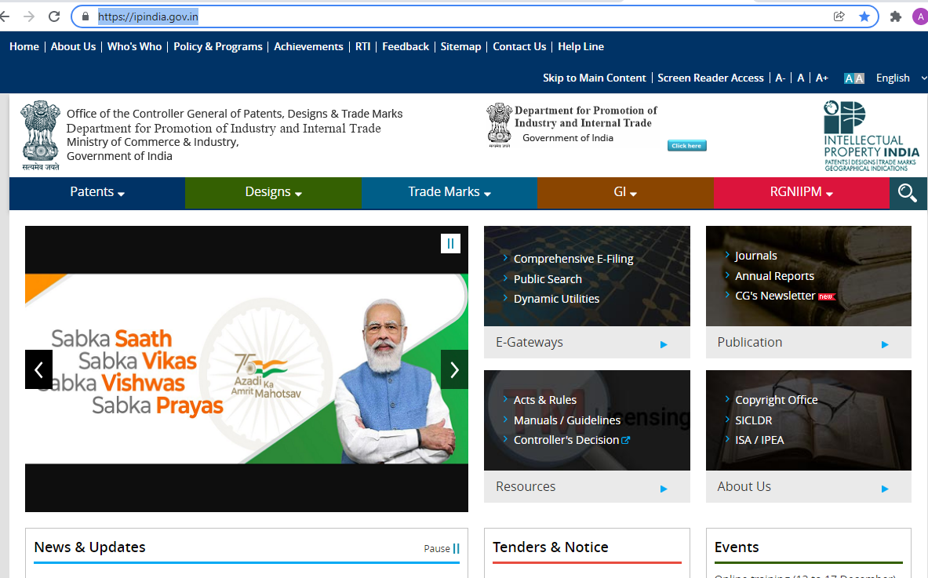
27

Slide 32
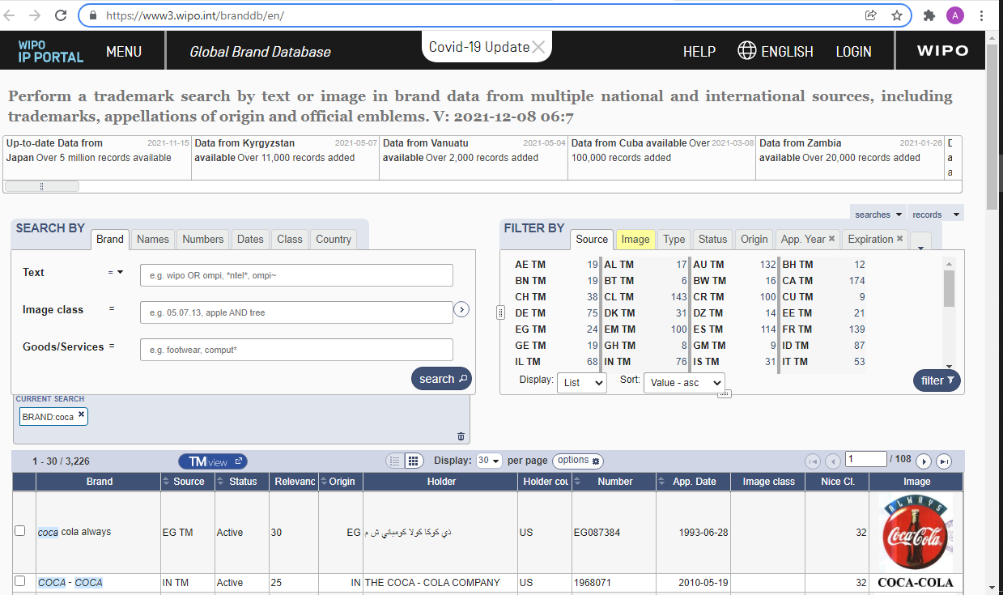

Slide 33
Patent

Slide 34
What Is a Patent?
A patent is the granting of a property right by a sovereign authority to an inventor. This grant provides the inventor exclusive rights to the patented process, design, or invention for a designated period in exchange for a comprehensive disclosure of the invention. They are a form of incorporeal right.
Government agencies typically handle and approve applications for patents. In the United States, the U.S. Patent and Trademark Office (USPTO), which is part of the Department of Commerce, handles applications and grants approvals.
Without material form or substance
A nation's ruler or head of state usually by hereditary right

Slide 35
A patent is the granting of a property right by a sovereign authority to an inventor.
A patent provides the inventor exclusive rights to the patented process, design, or invention for a certain period in exchange for a complete disclosure of the invention.
In June of 2018, the U.S. Patent and Trademark Office issued its 10 millionth patent.
Utility patents are the most common patent issued in the United States, accounting for 90% of all issued patents.
Utility and plant patents are granted for 20 years, whereas design patents are granted for either 14 or 15 years, depending on when filed.

Slide 36
Most patents are valid for 20 years in the U.S. from the date the application was filed with the USPTO, although there are circumstances where exceptions are made to extend a patent's term. U.S. patents are only valid in the United States and U.S. Territories.
If seeking protection outside of the United States, it is important to research the intellectual property rights of other nations and apply for protection with their governing authorities.

Slide 37
Types of Patents
There are three types of patents available in the United States: utility patents, design patents, and plant patents. Each has its own specifications and durations.
Utility Patents
Utility patents, or patents for invention, issue legal protection to people who invent a new and useful process, an article of manufacture, a machine, or a composition of matter.
Utility patents are the most common type of patent, with more than 90% of patents issued by the U.S. government belonging to this category.
A utility patent lasts for 20 years from the date of filing as long as maintenance fees are paid. Maintenance fees are surcharges applied to utility patent applications filed after December 12, 1980.

Slide 38
Design Patents
Design patents are patents issued for original, new, and ornamental designs for manufactured products.
Design patents protect the design or look of something. They require the invention to which the design belongs to be original and useful.
Design patents last for 15 years for applications filed after May 13, 2015. For applications filed before May 13, 2015, patents last for 14 years from the date of the filing.
Maintenance fees do not apply to design patents.

Slide 39
Plant Patents
Plant patents go to anyone who produces, discovers, and invents a new kind of plant capable of reproduction. These patents are granted for 20 years from the date of filing and no maintenance fees apply.
Patents provide an incentive for companies or individuals to continue developing innovative products or services without the fear of infringement. For example, large pharmaceutical companies can spend billions of dollars on research and development. Without patents, their drugs and medicines could be duplicated and sold by companies that didn't research or invest the needed capital for R&D.
In other words, patents protect the intellectual property of companies to help their profitability. However, patents also serve as bragging rights for companies demonstrating their innovativeness.

Slide 40
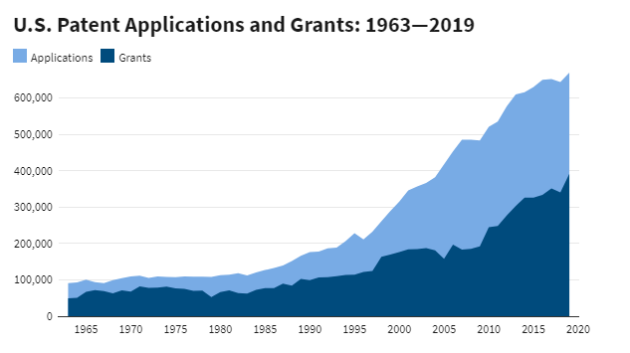

Slide 41
Examples of Patents
One of the most notable patents in the past 40 years was the personal computer filed in 1980 by Steve Jobs and three other employees of Apple Inc.
King C. Gillette patented the razor in 1904 and was dubbed a "safety razor."
Garrett Morgan was granted a patent for the traffic light in 1923.
The patent for the television was issued in 1930 to Philo Taylor Farnsworth for the "first television system.“ At age 20, Farnsworth had created the first electric television image and went on to invent an early model of the electronic microscope.

Slide 42
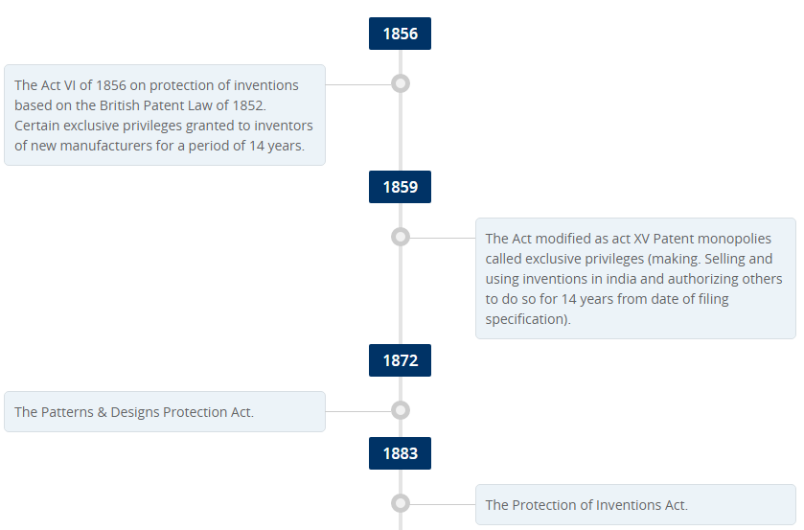
History of Indian Patents

Slide 43
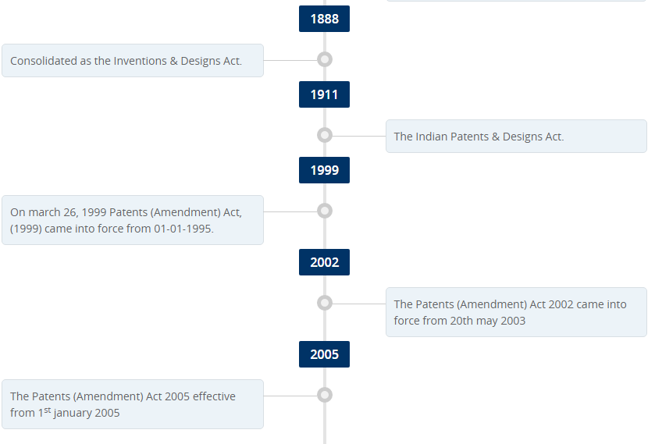
History of Indian Patents

Slide 44
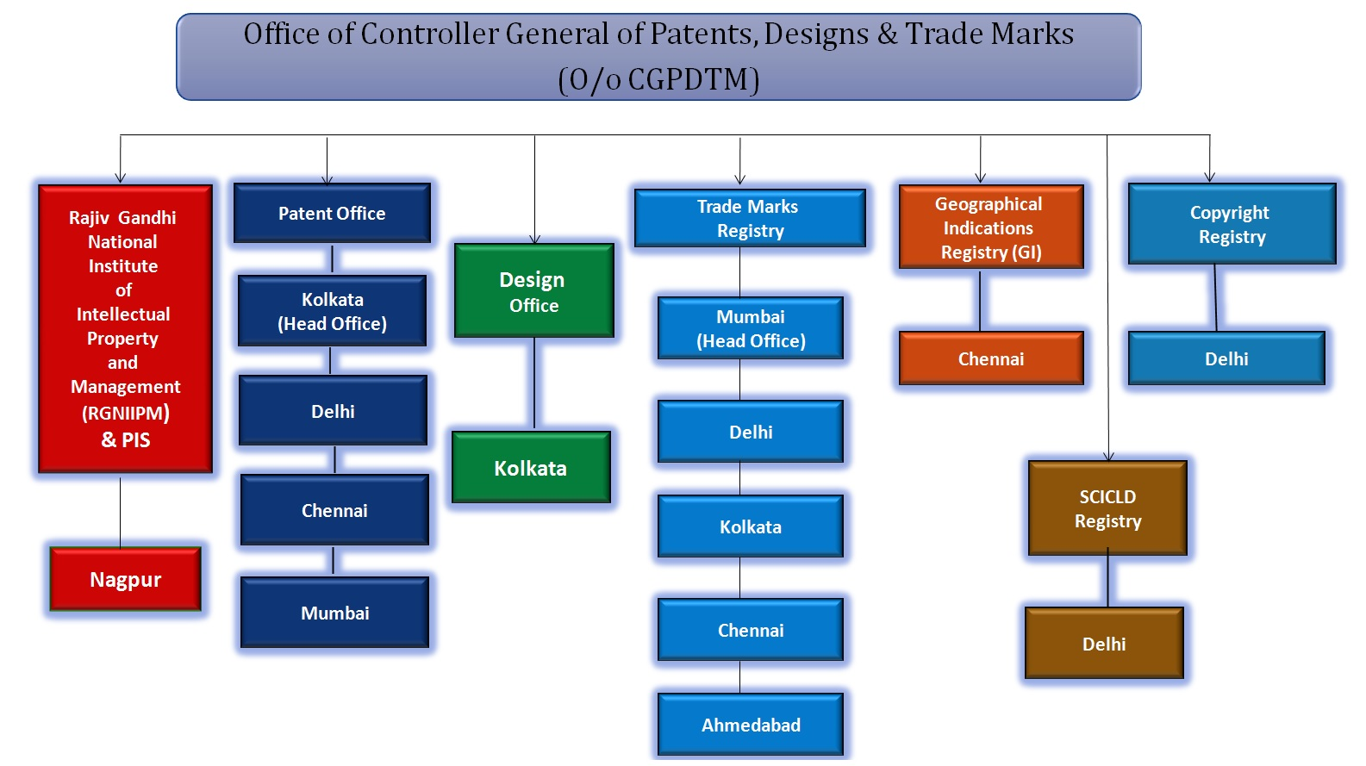
https://ipindia.gov.in/writereaddata/Portal/IPOFormUpload/1_11_1/Fees.pdf
https://ipindia.gov.in/writereaddata/Portal/Images/pdf/Final_FREQUENTLY_ASKED_QUESTIONS_-PATENT.pdf

Slide 45
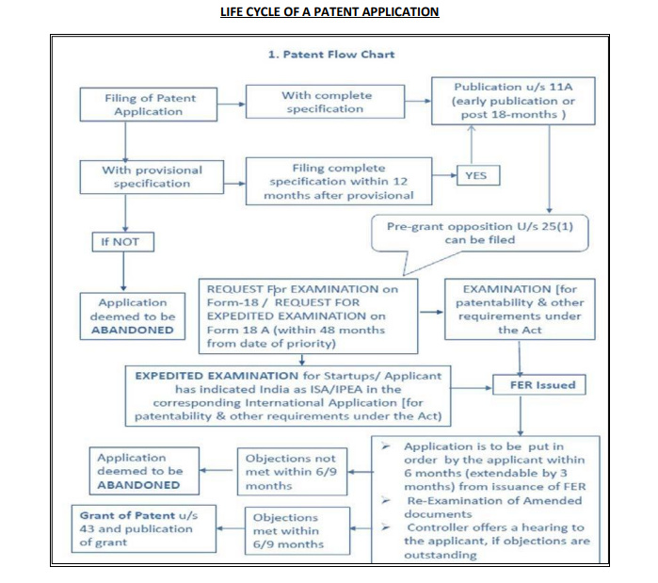
First Examination Report (FER)

Slide 46
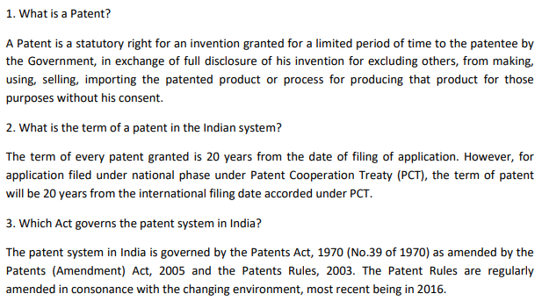
The Patent Cooperation Treaty (PCT) makes it possible to seek patent protection for an invention simultaneously in each of a large number of countries by filing an "international" patent application.

Slide 47
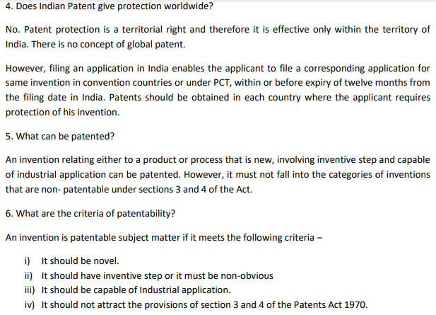

Slide 48
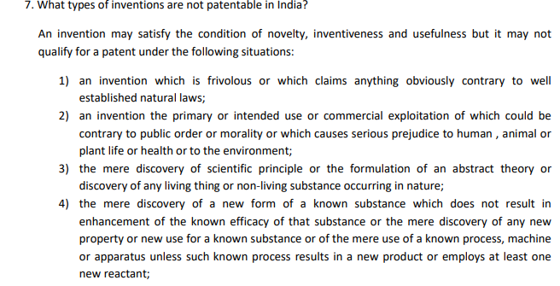

Slide 49
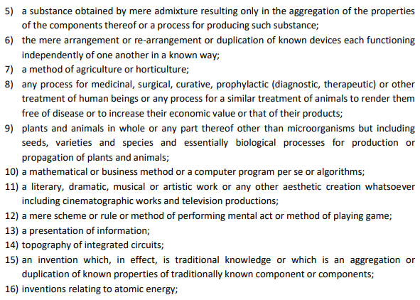

Slide 50
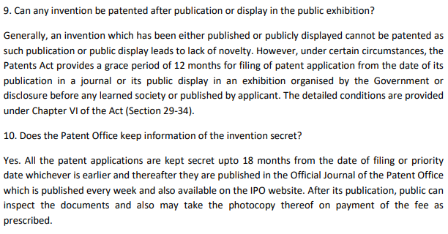

Slide 51
Copyright

Slide 52
What is copyright?
Copyright (or author’s right) is a legal term used to describe the rights that creators have over their literary and artistic works.
Works covered by copyright range from books, music, paintings, sculpture, and films, to computer programs, databases, advertisements, maps, and technical drawings.

Slide 53
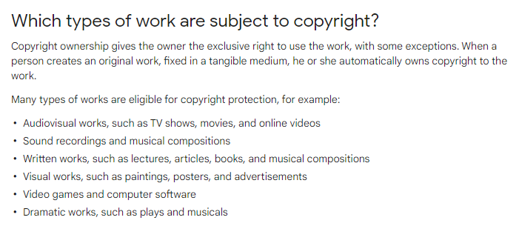
What can be copyrighted?
Copyright protection extends only to expressions, and not to ideas, procedures, methods of operation or mathematical concepts as such. Copyright may or may not be available for a number of objects such as titles, slogans, or logos, depending on whether they contain sufficient authorship.

Slide 54
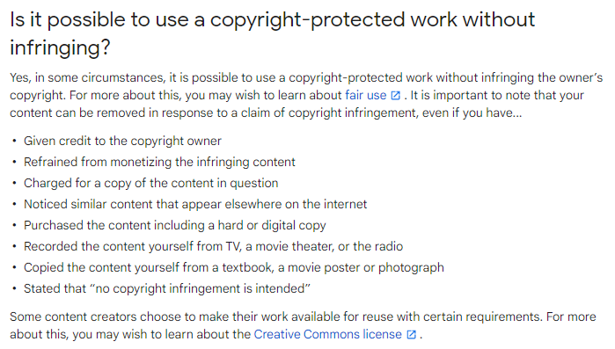

Slide 55
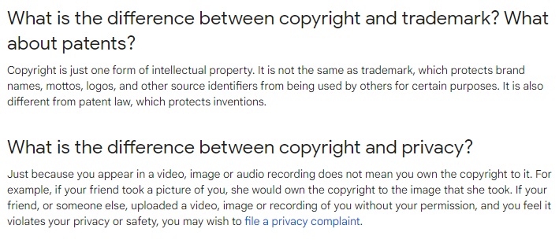

Slide 56
There are two types of rights under copyright:
economic rights, which allow the rights owner to derive financial reward from the use of their works by others; and
moral rights, which protect the non-economic interests of the author.
Most copyright laws state that the rights owner has the economic right to authorize or prevent certain uses in relation to a work or, in some cases, to receive remuneration for the use of their work (such as through collective management). The economic rights owner of a work can prohibit or authorize:
its reproduction in various forms, such as printed publication or sound recording;
its public performance, such as in a play or musical work;
its recording, for example, in the form of compact discs or DVDs;
its broadcasting, by radio, cable or satellite;
its translation into other languages; and
its adaptation, such as a novel into a film screenplay.

Slide 57
In the past, some countries had legislation in place that required the copyright holder to comply with certain formalities in order to receive copyright protection.
One of those formalities was to include an indication that copyright had been claimed, such as by using the symbol ©.
Currently, very few countries still impose formalities on copyright, therefore the use of such symbols is no longer a legal requirement.
Nonetheless, many right owners still include the symbol © as a highly visible way to emphasize that that work is protected by copyright and that all rights are reserved, as opposed to a less restrictive license.

Slide 58
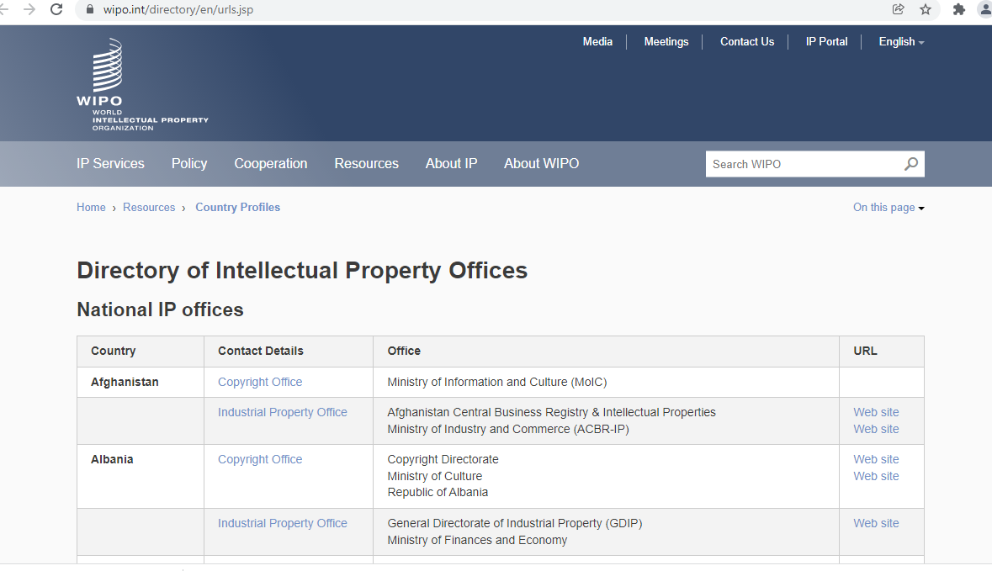

Slide 59
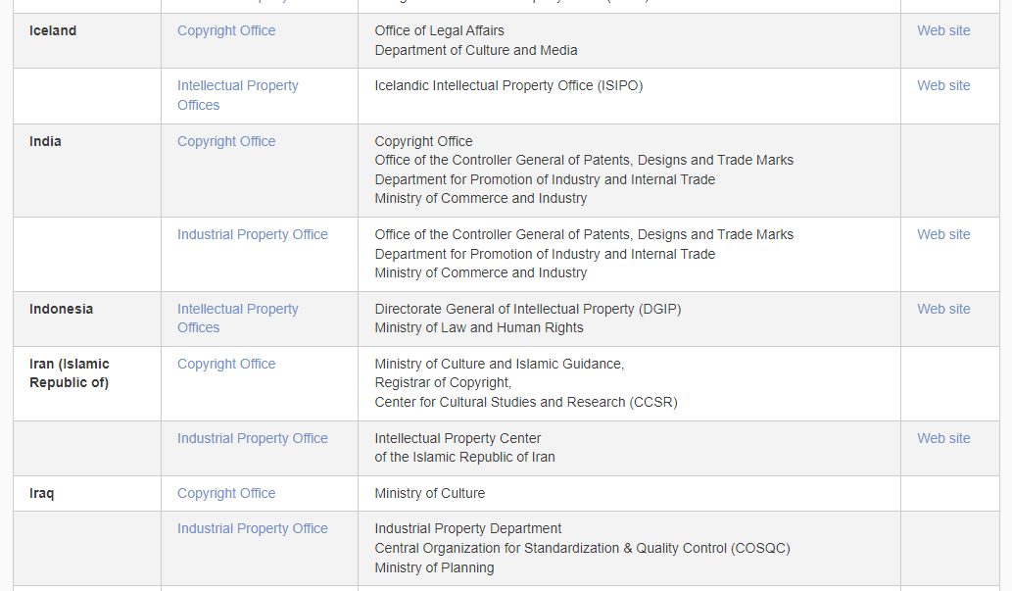

Slide 60
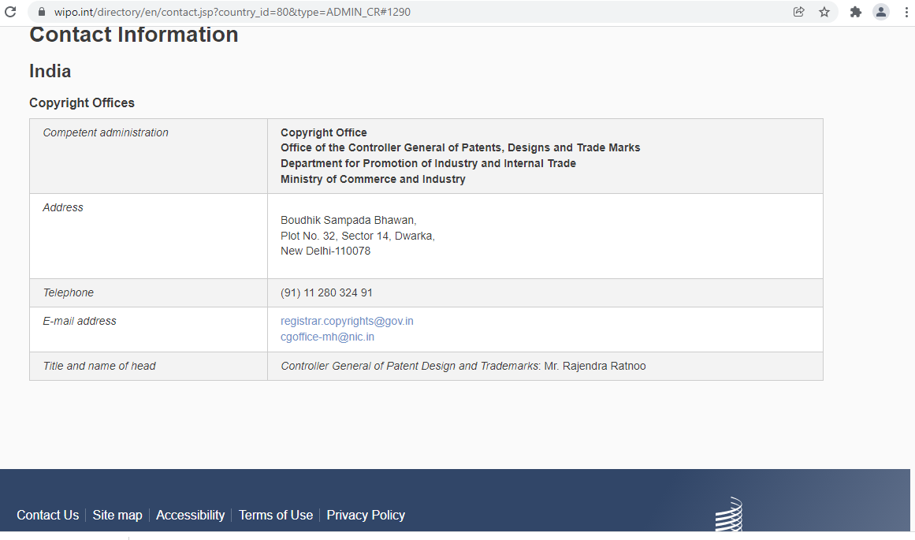

Slide 61
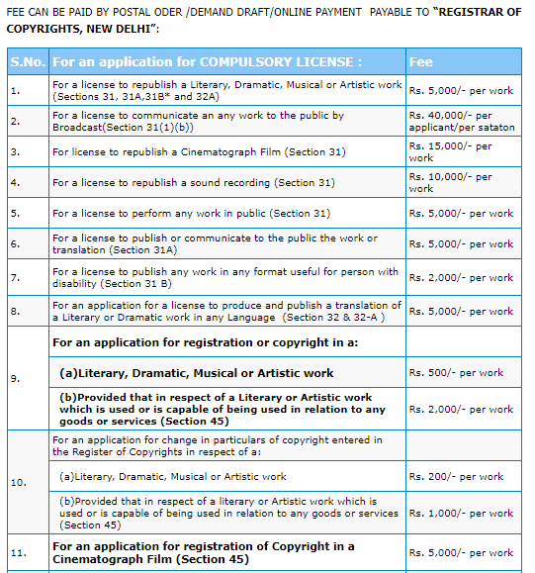
https://copyright.gov.in/

Slide 62
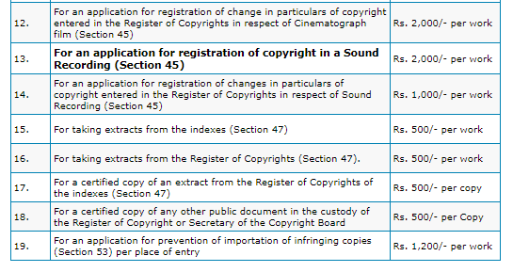

Slide 63
